Slide 1

Application Development with C++ (ELEC362)
Lecture 18: Advanced input/output features, saving and serialisation.
mihasan@liverpool.ac.uk

Slide 2
Previous lecture
In the previous lecture, different drawing/graphics approaches in Qt were discussed.
Painting on widgets was discussed.
Handling graphics using the Graphics View Framework was discussed.
Classes introduced: QPainter, QPen, QBrush, QRectF, QTimer, QGraphicsView, QGraphicsScene, QGraphicsItem, QTransform

Slide 3
This lecture
What is covered in this lecture?
Enabling advanced input/output by the user in Qt applications.
Why it is covered?
Loading/saving is a standard functionality in most applications nowadays.
How are topics covered in this lecture: Live demonstrations

Slide 4
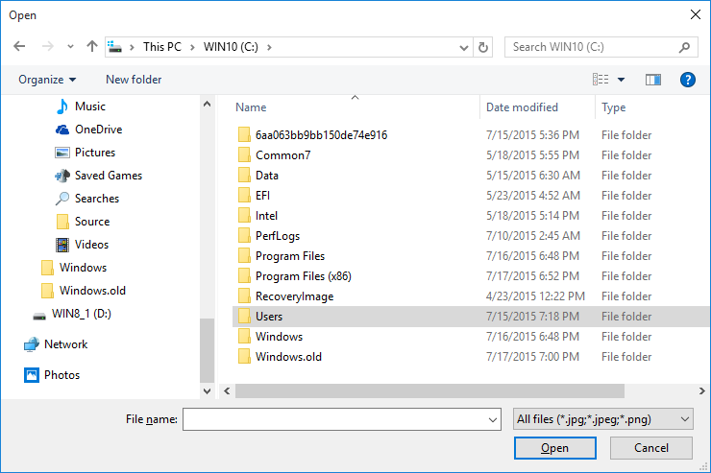
Custom input classes
What if the user wants to have a “custom” input that is not a direct input?
Qt has a range of input dialogs (all derived from QDialog):
QFileDialog: Shows the window for opening a file of any type.
It obtains a path to the required
file the user inputs to the programme.
Reference: https://doc.qt.io/qt-6.2/qfiledialog.html
Pointer to parent widget
Title of the window
QString file = QFileDialog::getSaveFileName(this,"Save file");

Slide 5
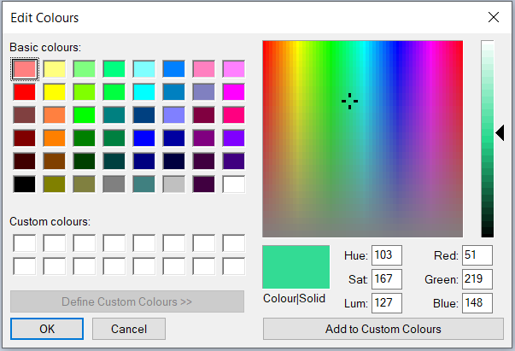
Custom input classes
QColorDialog: Shows the window for selecting a colour.
It returns an object of the class
QColor.
Reference:
https://doc.qt.io/qt-6/qcolordialog.html
Example:
QColor user_clr = QColorDialog::getColor(Qt::white,this,“Get Color");
Title of the window
Default color
Pointer to parent widget

Slide 6
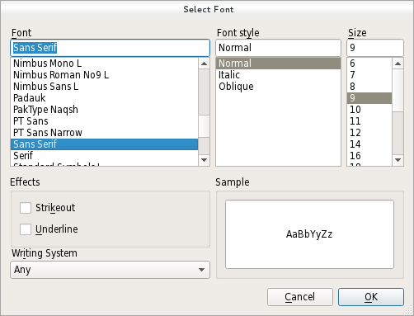
Custom input classes
QFontDialog: Shows the window for selecting a font.
It returns an object of the class
QFont.
Reference:
https://doc.qt.io/qt-6/qfontdialog.html
Example:
QFont user_font = QFontDialog::getFont(&ok,QFont(“Times”,12), this);
Reference to bool
Default font
Title of the window

Slide 7
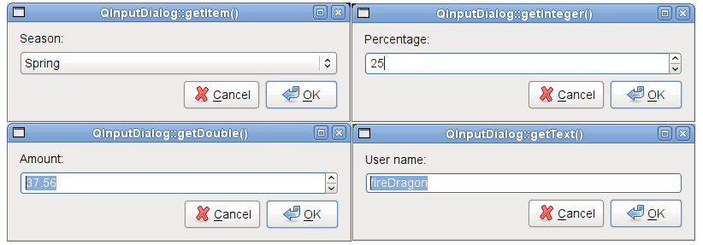
Custom input classes
QInputDialog: Shows a simple pre-defined Dialog for simple input from the user
It returns an object or a variable of any type:
Reference: https://doc.qt.io/qt-6/qinputdialog.html

Slide 8
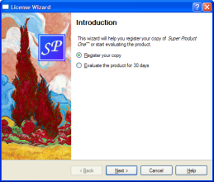
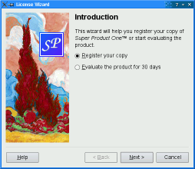
Custom input classes
QWizard: Shows a pre-defined wizard interface.
It offers different styles.
Reference: https://doc.qt.io/qt-6.2/qwizard.html

Slide 9

Loading and Saving text files
The loading-saving functionality can be added to any application developed in Qt, using a combination of the following classes:
The data in the App
Class | Is used for
QFileDialog | Asking the user to specify the path and location of the file to be input/output
QFile | Creating a file/Opening a file
QTextStream | Reading and writing data to a file
QFileDialog object
QFile object
QTextStream object

Slide 10
QFile and QTextStream Classes
The QFile class provides an interface for reading and writing files.
Reference: https://doc.qt.io/qt-6/qfile.html
An object of this class is the actual file that might be read or written.
The QTextSream class provides an easy way to write, format and manipulate text streams.
Reference: https://doc.qt.io/qt-6/qtextstream.html
It can be used for file input and output, or it can be used for formatting local variables in the application.

Slide 11
A sample application: Notes saver
The task: Design and implement a Qt-based GUI application that allows the user to save and load notes written as text to the application.
Build the application (demonstration).
Practical note:
In Qt, it is best to define Loading/Saving as actions.
When coding for saving and loading functionalities, always start by implementing saving before loading.
Make sure the file is open before reading it, and make sure to close it after writing.

Slide 12
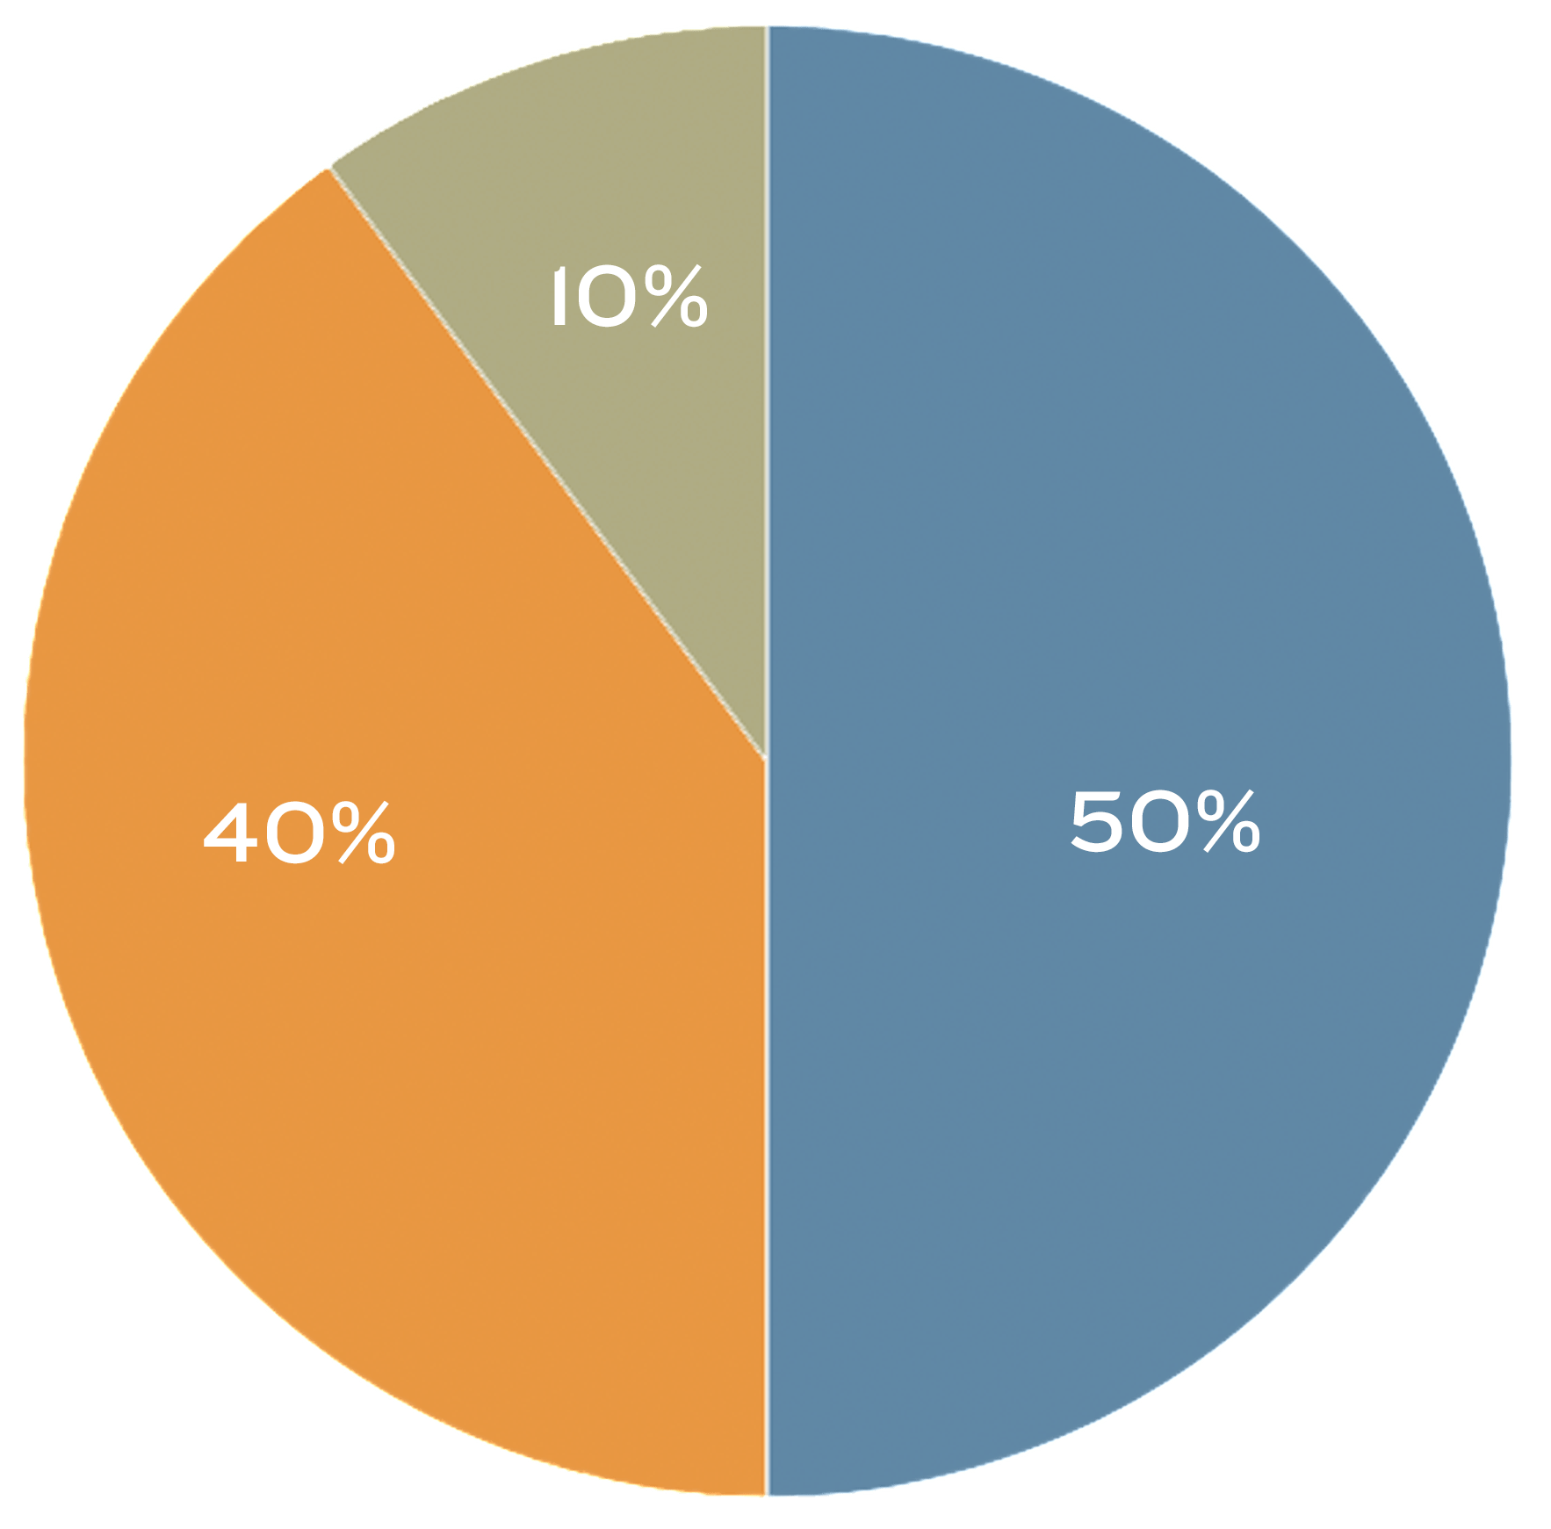

Serialisation
How is it possible to save a drawing or a game?
The vital step to save/load non-trivial file is to determine the information required to fully restore the application to the point where it is left.
Serialisation is the process of converting objects into a one-dimensional stream of data to be saved. Then resort the original structure through “deserialisation”.
QDataStream writing
Serialise
QColor C;
C=(Qt::blue);
int C =50;
QColor D;
D=(Qt::grey);
int D =10;
QColor F;
F=(Qt::red);
int F =40;
Deserialise
QDataStream reading

Slide 13
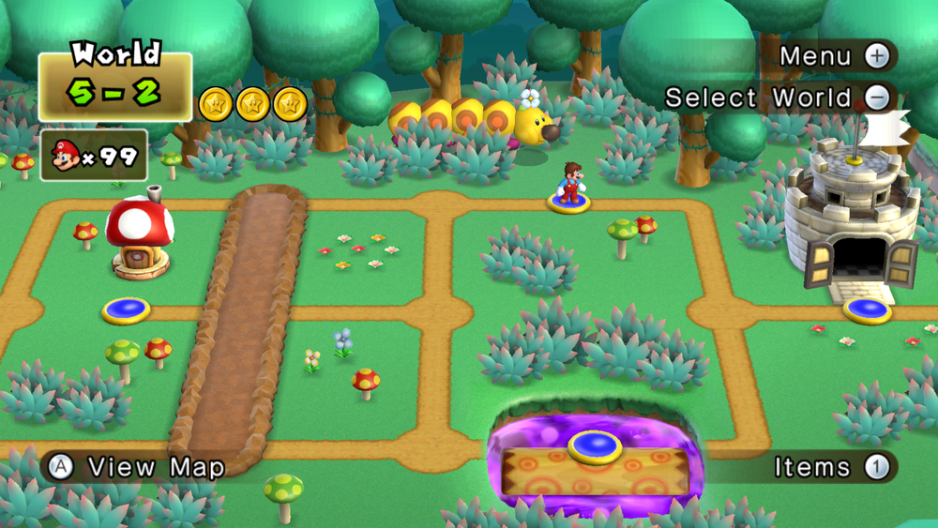
Serialisation
QUESTION: Identify the data that needs saving to restore the game to this status?

Slide 14
QDataStream Class
This class provides an easy way to write, format and manipulate streams for any data type, or a combination of different datatypes.
Reference: https://doc.qt.io/qt-6/qdatastream.html
It serves an identical role of QTextStream but for other datatype.
Make sure the order of extraction of data in deserlisation is the exact opposite of that in serialisation.

Slide 15
A sample application: Drawing saver
The task: Draw few shapes using the graphics view framework and implement a serialisation function to save them. And a deserialisation function to load them.
Build the application (demonstration).
Practical note:
Data containers such as QVector and QList are quite useful for saving non-text data.

Slide 16
Summary
In this lecture, non-direct input/output of data to applications were discussed.
For simple user inputs, many classes derived from QDialog are pre-defined to get user choices of colour, font, or files.
Input / Output functionality of text files was discussed.
The concept of serialisation was introduced, and input / output for arbitrary data types was discussed.
Classes covered: QFileDialog, QFontDialog, QColorDialog, QInputDialog, QWizard, QTextStream, QFile, QDataStream

